Slide 1

Department of Information Technology
Safe Folder app
Project Group Members | Roll no
Jha Nishantkumar H. | 26
Suryarao Ketan | 51
Yeole Gauresh | 63
Under Guidance of Prof. V.M. Kharche

Slide 2
content
Abstract
Introduction
Literature Survey
Objectives
Problem statement
System Requirements
Snapshots
Future Scope
Limitations
Advantages and Disadvantages
Conclusion
References

Slide 3
INTRODUCTION
Now a day's most users are facing problems with providing security to the files and folders. Sometimes our folder is going to be corrupted by an unauthorized user which will corrupt our important files. And sometimes sharing a personal device can be beneficial, but it comes with the risk that others might access your personal files. To keep personal content safer, we're launching the Safe Folder application that will provide security to files & folders and also save it from unauthorized user.

Slide 4
Literature Survey
SR NO. | Research paper Name | Author-Year | Requirements of project in Research paper
1. | Research on a Normal File Encryption and Decryption | Guy-Armand Yandji, Lui Lian Hao, Amir-Eddine Youssouf, Jules Ehoussou (May 2011) | In this paper, our strategy used is to apply the encryption methods of the AES and MD5 following some steps in the encryption process in order to produce an outcome of a file that will, as a result, be hashed and strongly decrypted through the robust software for file storing
2 | Separable reversible encrypted data hiding in the encrypted image using AES Algorithm and Lossy technique | Parag Kadam, Akash Kandhare, Mangesh Nawale, Mukesh Patil (April 2013) | AES algorithm is a symmetric block cipher that can be used for encrypting (encipher) and decrypting (decipher) data.

Slide 5
Sr.No. | Paper Title | Author-Year | Description
3. | Implementation of Reconfigurable Data Encryption Technique using different AES versions | Anirudh P S, Lalu V (March 2011) | The Advanced Encryption Standard is widely used for encrypting data today. Unauthorized individuals will not be able to access data encrypted using AES. This paper presents the implementation of three different variants of AES in FPGA using Reconfiguration.
4. | Implementation of AES algorithm using VHDL | Amit Kumar, Manoj Kumar, P. Balramudu (Feb- 2018) | AES algorithm is a symmetric block cipher that can be used for encrypting (encipher) and decrypting (decipher) data.
5. | Encryption and decryption Implementation in Java-based on Poco libraries | Wang Fei, Luo Ming, Hu Fangming (October 2011) | The conventional Java-based method of data encryption and decryption exists such problems as low efficiency and complicated programming.

Slide 6
Objectives
Due to the statement of this literature survey, we have some objectives to achieve sucess in this project -
Our main objective of this project is to develop a more secure app
To build a system that can encrypt images, videos, and files.
The system design will be an alphanumeric authentication system.
Build a new algorithm for the security model for the data encryption and decryption.

Slide 7
Problem statement
While encryption any images, videos, or files our most challenging job is it should encrypt quickly & store them properly.
All the encrypted Information should be encrypted or decrypted by the user without facing any problem.

Slide 8
System requirements
HARDWARE REQUIREMENTS :-
Multi-core processor
4GB RAM minimum
250 GB Hard Disk
SOFTWARE REQUIREMENTS :-
Windows 7 or higher.
Android Studio

Slide 9
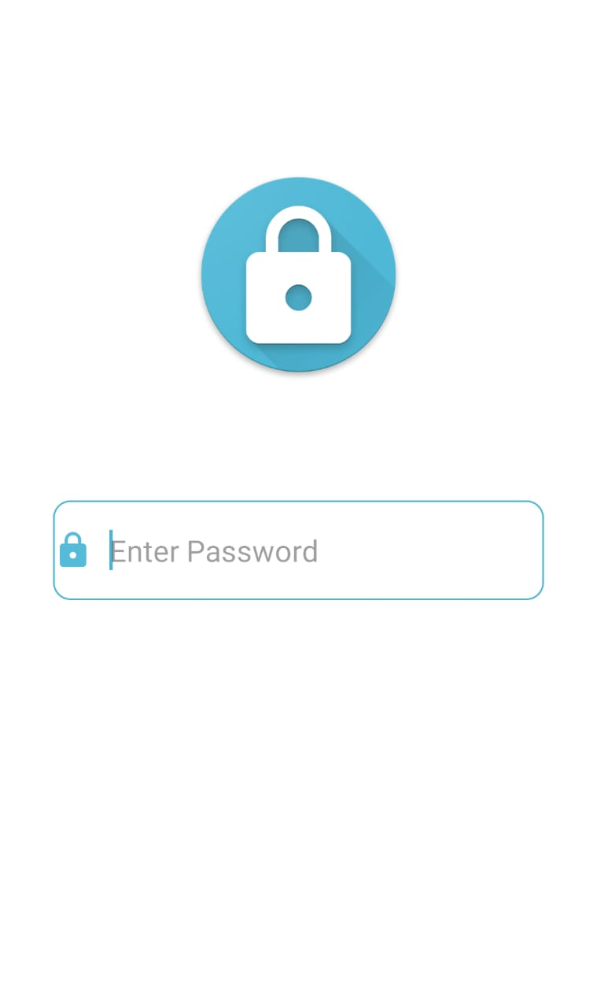
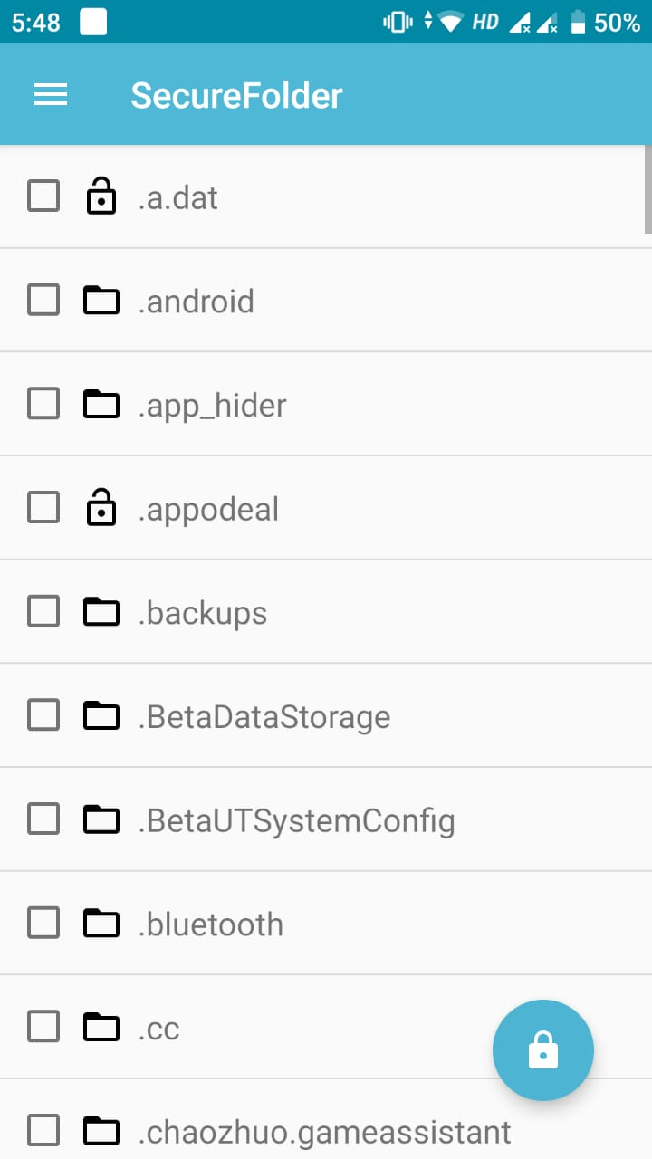
Snapshots of the running application

Slide 10
Future scope
This Application will be the right choice for the users.
In future lots of new features were updated like new themes, customized app, time lock in that auto lock/unlock according to time, location lock according to location.
Hidden Applock icon and also provide advanced protection which prevent applock being killed by task killer.
We can also add applock widget in which user can enable/disable applock with one tap.
We can also give the low memory usage and power saving mode from which user can use device even after the low battery.

Slide 11
limitations
This application is available for only android user.
User can store their personal files and folders with limited space only .
User cannot customized the application.

Slide 12
Advantages and disadvantages
ADVANTAGES :-
This app is encrypting sensitive files directly on the SD card.
No data is sent over the internet.
DISADVANTAGES :-
This application works only on android devices.

Slide 13
CONCLUSION
Safe Folder App is a best app for the today’s generation . This app gives many features to the user and this is safely to use. We are highly satisfied and motivated by the results obtained at the end of this project. The Project was a new experience when it came to the testing phase. Safe Folder App has many possibilities for the future enhancement and availability for better privacy of the user. In future we will try to add more features in this app and making more easier, reliable and user-friendly.

Slide 14
References
https://www.computerworld.com/article/3221287/android-file-management-an-easy-to-follow-guide.html
https://stackoverflow.com/questions/4275311/how-to-encrypt-and-decrypt-file-in-android/8041442
https://developer.android.com/guide/topics/security/cryptography
https://www.javatpoint.com/android-tutorial

Slide 15
THANK YOU

